Slide 1
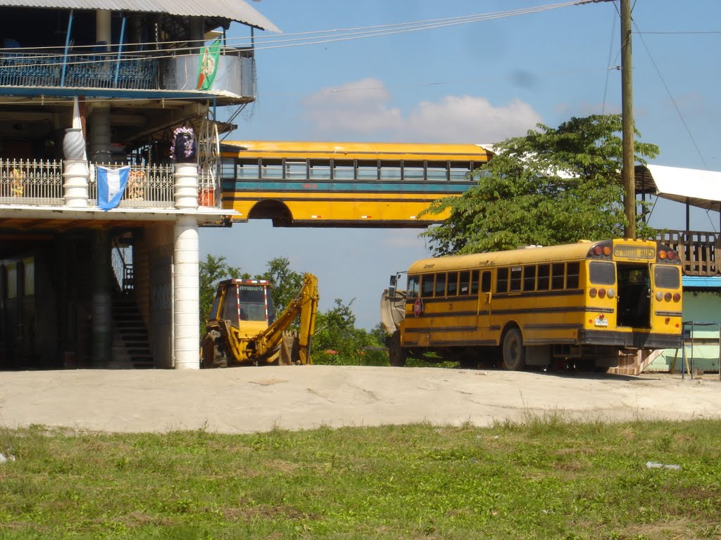
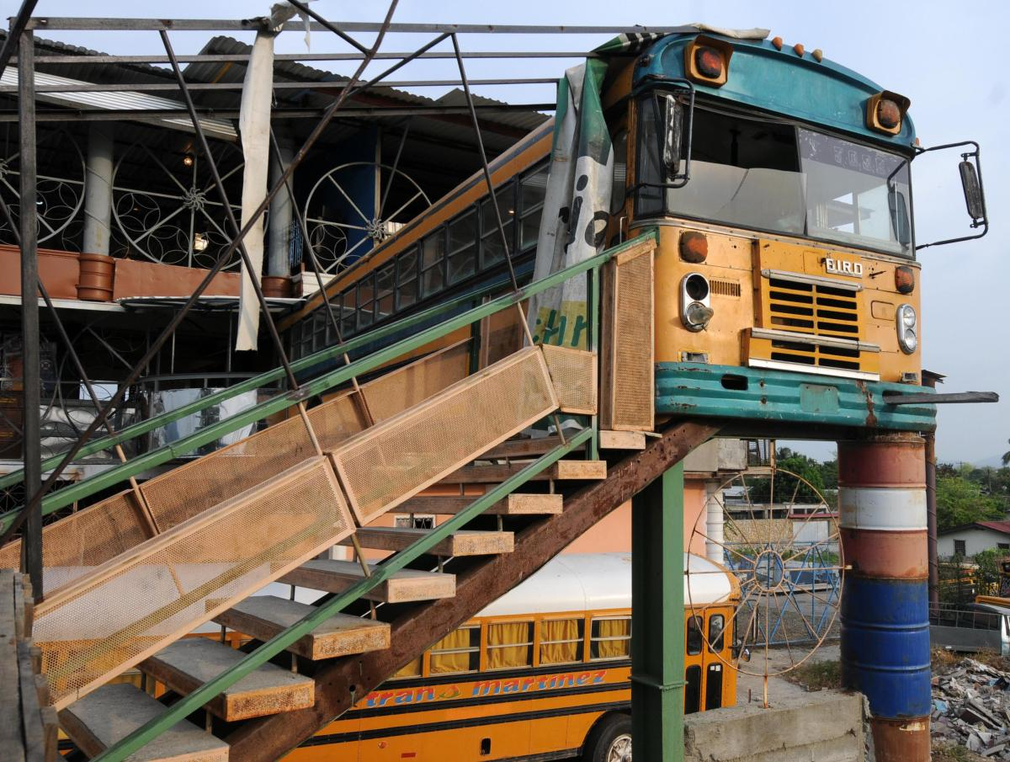
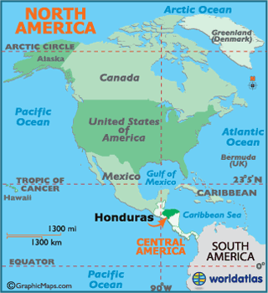
Translate a. We prepare dinner in the kitchen. b. My cat drinks milk. c. The boys do not run in the living room.
La capital es Tegucigalpa.

